Slide 1
SQL SERVER- PART II
AMOL R PATIL PUNE

Slide 2
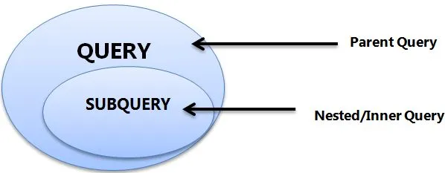
Subqueries
A Subquery, also named as the inner query or nested query is a query within another SQL query and embedded within the WHERE clause.
A subquery helps to return data used by the main query as a condition to restrict the data retrieval further.
Subqueries are majorly used with SELECT, INSERT, UPDATE, and DELETE statements along with comparison operators like =, <, >, >=, <=, IN, BETWEEN, etc.

Slide 3
The subquery can be nested inside a SELECT, INSERT, UPDATE, or DELETE statement or inside another subquery.
A subquery is usually added within the WHERE Clause of another SQL SELECT statement.
You can use the comparison operators, such as >, <, or =. The comparison operator can also be a multiple-row operator, such as IN, ANY, or ALL.
Subquery should be enclosed within parentheses.
Subqueries are always to the right of the comparison operators.
We can’t use Order By clause in the subquery; instead, we can use the Group By clause.
The inner query executes first before its parent query so that the results of an inner query can be passed to the outer query.

Slide 4
Types of Subqueries
Single row subquery : Returns zero or one row.
Multiple row subquery : Returns one or more rows.
Multiple column subqueries : Returns one or more columns.
Correlated subqueries : Reference one or more columns in the outer SQL statement. The subquery is known as a correlated subquery because the subquery is related to the outer SQL statement.
Nested subqueries : Subqueries are placed within another subquery.

Slide 5
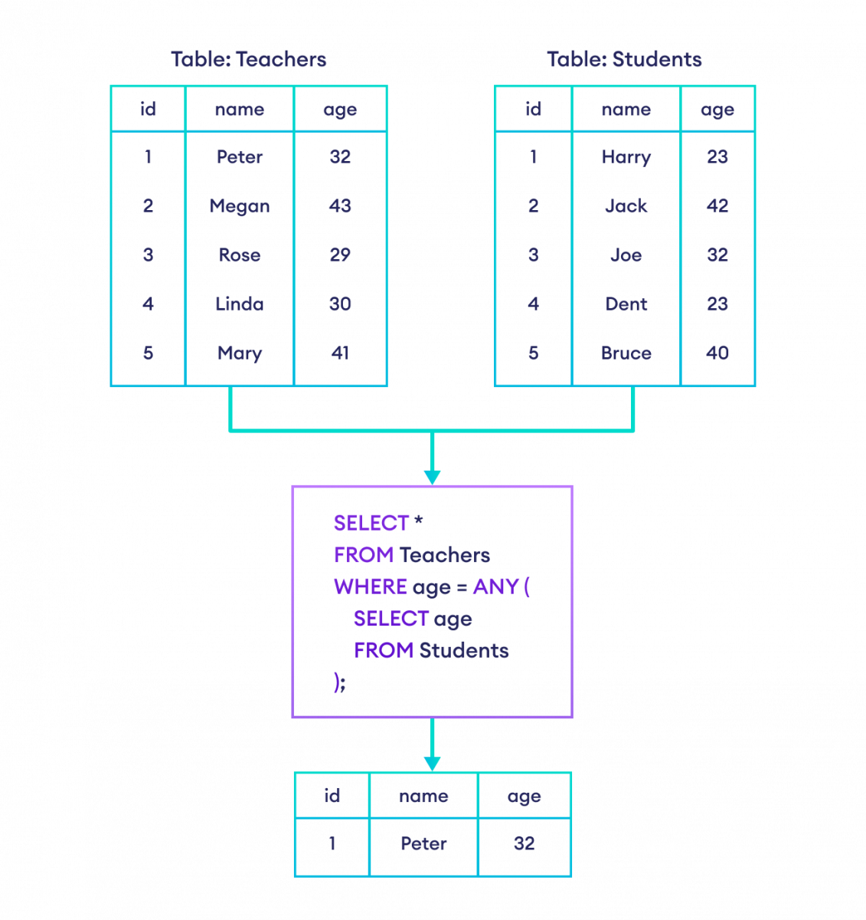
SQL Any and All
SQL ANY compares a value of the first table with all values of the second table and returns the row if there is a match with any value.
SELECT column
FROM table1
WHERE column OPERATOR ANY (
SELECT column
FROM table2
);
we want teachers whose age is equals to any student.

Slide 6
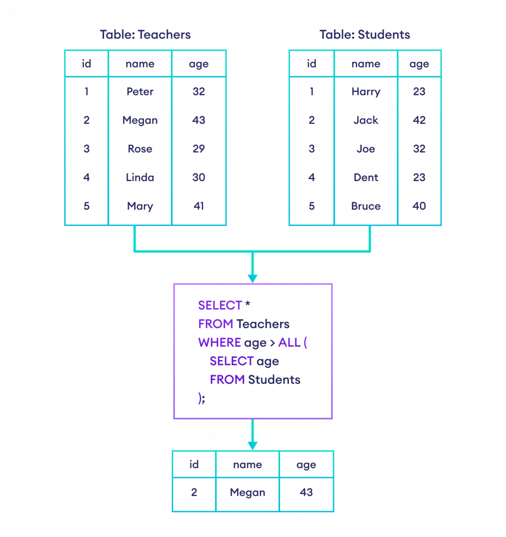
SQL Any and All
SQL ALL compares a value of the first table with all values of the second table and returns the row if there is a match with all values.
SELECT column
FROM table1
WHERE column OPERATOR ALL (
SELECT column
FROM table2
);
find teachers whose age is greater than all students

Slide 7
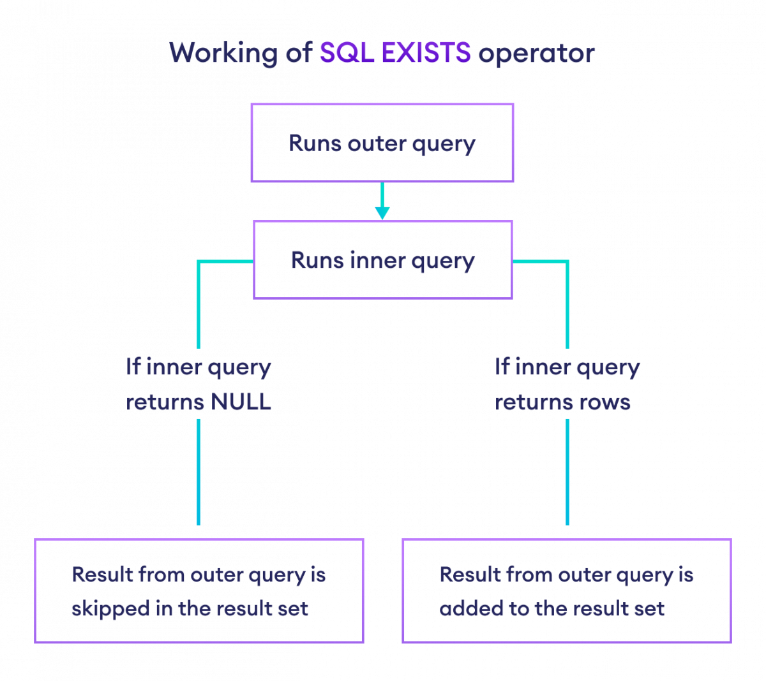
Exists Operator
The SQL EXISTS operator tests the existence of any value in a subquery i.e. it executes the outer SQL query only if the subquery is not NULL (empty result-set).
SELECT column1, column2, ...
FROM table
WHERE EXISTS(SUBQUERY);

Slide 8
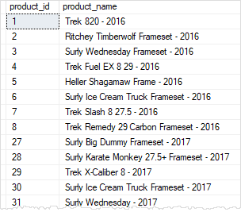
Assignment Subquery
Write query to find the names of all mountain bikes and road bikes products that the Bike Stores sell.

Slide 9
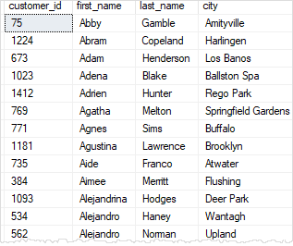
Assignment Subquery - Exists
finds the customers who bought products in 2017:

Slide 10
Assignment Subquery
finds the customers who bought products in 2017:

Slide 11
Correlated Subquery
A correlated subquery is a subquery that uses the values of the outer query. In other words, the correlated subquery depends on the outer query for its values.
Because of this dependency, a correlated subquery cannot be executed independently as a simple subquery.
Moreover, a correlated subquery is executed repeatedly, once for each row evaluated by the outer query. The correlated subquery is also known as a repeating subquery.

Slide 12
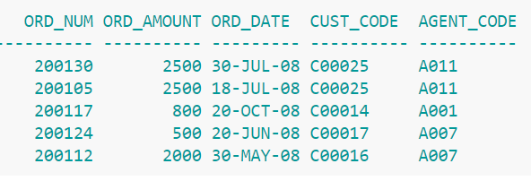
Subquery Assignment
Find details of orders for agents who are working in Bangolre area
Find details of orders for agents who are not working in Bangolre area

Slide 13
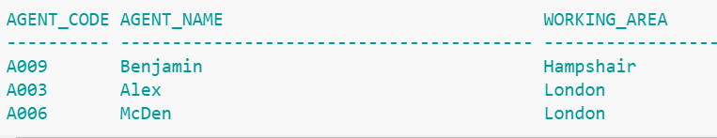
Subquery Assignment
Get Details of agents for customer country ‘UK’

Slide 14
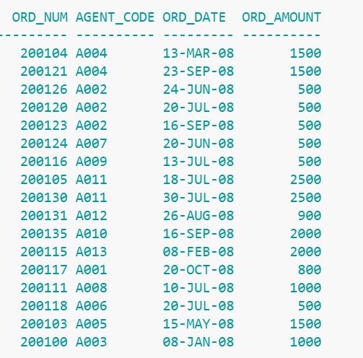
Subquery Assignment
Get Details order amount with the lowest price, group by agent code.’

Slide 15
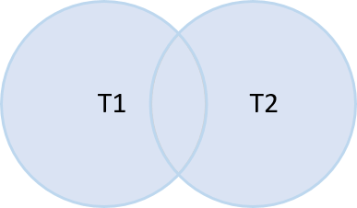
SQL Server Union
SQL Server UNION is one of the set operations that allow you to combine results of two SELECT statements into a single result set which includes all the rows that belong to the SELECT statements in the union.
The following are requirements for the queries in the syntax above:
The number and the order of the columns must be the same in both queries.
The data types of the corresponding columns must be the same or compatible.

Slide 16
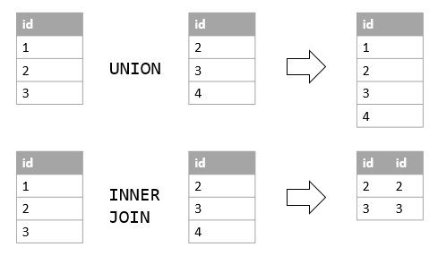
Union Vs. Join

Slide 17
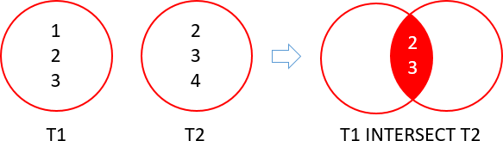
Intersect
The SQL Server INTERSECT combines result sets of two or more queries and returns distinct rows that are output by both queries.

Slide 18
View in SQL
A view is a named query stored in the database catalog that allows you to refer to it later.
A view may consist of columns from multiple tables using joins or just a subset of columns of a single table. This makes views useful for abstracting or hiding complex queries.
CREATE VIEW [OR ALTER] schema_name.view_name [(column_list)]
AS
select_statement;

Slide 19
View in SQL
To remove a view from a database, you use the DROP VIEW
DROP VIEW [IF EXISTS] schema_name.view_name;
If you want to rename a view programmatically, you can use the sp_rename stored procedure:
EXEC sp_rename
@objname = 'sales.product_catalog’,
@newname = 'product_list’;
Get Information of View
EXEC sp_helptext 'sales.product_catalog' ;

Slide 20
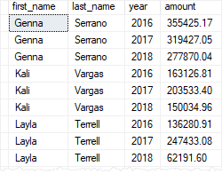
Assignment - View
create a view named staff_salesthose that summaries the sales by staffs and years using the SUM() aggregate function:

Slide 21
Stored Procedure
SQL Server stored procedures are used to group one or more Transact-SQL statements into logical units.
The stored procedure is stored as a named object in the SQL Server Database Server.
When you call a stored procedure for the first time, SQL Server creates an execution plan and stores it in the cache. In the subsequent executions of the stored procedure, SQL Server reuses the plan to execute the stored procedure very fast with reliable performance.

Slide 22
Stored Procedure Syntax
CREATE PROCEDURE [schema_name].procedure_name
@parameter_name data_type,
....
parameter_name data_type
AS
BEGIN
-- SQL statements
-- SELECT, INSERT, UPDATE, or DELETE statement
END
Executing a stored procedure : EXECUTE / EXEC <name>

Slide 23
Stored Procedure Operations
Create Simple Procedure
Modify Procedure using Alter Statement
Delete procedure using Drop Statement
Create Procedure with Single Parameter
Create Procedure with Multiple Parameters
Create Procedure with Default Parameter Values
Create Procedure with OUTPUT Parameters

Slide 24
Variables
A variable is an object that holds a single value of a specific type e.g., integer, date, or varying character string.
To declare a variable, you use the DECLARE statement.
DECLARE @model_year SMALLINT;
DECLARE @model_year AS SMALLINT;
DECLARE @model_year SMALLINT, @product_name VARCHAR(MAX);
DECLARE @count int OUTPUT;
Assigning a value to a variable
SET @model_year = 2018;

Slide 25
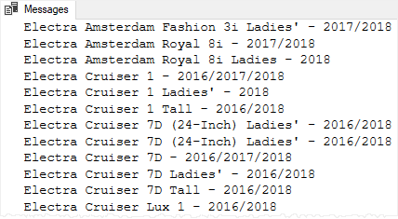
Stored Procedure Assignment
Write a stored Procedure which takes model year as parameter and prints product list of that year

Slide 26
If-Else
IF Boolean_expression
BEGIN
-- Statement block executes when the Boolean expression is TRUE
END
ELSE
BEGIN
-- Statement block executes when the Boolean expression is FALSE
END

Slide 27
While loop
WHILE Boolean_expression
{ sql_statement | statement_block}
e.g.
DECLARE @counter INT = 1;
WHILE @counter <= 5
BEGIN
PRINT @counter;
SET @counter = @counter + 1;
END

Slide 28
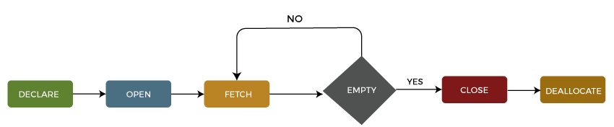
Database Cursor
A database cursor is an object that enables traversal over the rows of a result set. It allows you to process individual row returned by a query
The SQL Server cursor's purpose is to update the data row by row, change it, or perform calculations that are not possible when we retrieve all records at once

Slide 29
Database Cursor Operations
1: Declare Cursor :
DECLARE cursor_name CURSOR
FOR select_statement;
2: Open Cursor OPEN cursor_name;
3: Fetch Cursor FETCH NEXT FROM cursor INTO variable_list;
WHILE @@FETCH_STATUS = 0
BEGIN
FETCH NEXT FROM cursor_name;
END;

Slide 30
Database Cursor Operations
4: Close Cursor CLOSE cursor_name;
5: Deallocate Cursor DEALLOCATE cursor_name;

Slide 31
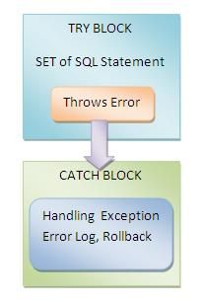
Exception Handling
The TRY CATCH construct allows you to gracefully handle exceptions in SQL Server. To use the TRY CATCH construct, you first place a group of Transact-SQL statements that could cause an exception in a BEGIN TRY...END TRY
BEGIN TRY
-- statements that may cause exceptions
END TRY
BEGIN CATCH
-- statements that handle exception
END CATCH

Slide 32
Catch Block Functions
Inside the CATCH block, you can use the following functions to get the detailed information on the error that occurred:
ERROR_LINE() returns the line number on which the exception occurred.
ERROR_MESSAGE() returns the complete text of the generated error message.
ERROR_PROCEDURE() returns the name of the stored procedure or trigger where the error occurred.
ERROR_NUMBER() returns the number of the error that occurred.
ERROR_SEVERITY() returns the severity level of the error that occurred.
ERROR_STATE() returns the state number of the error that occurred.

Slide 33
User Defined Functions
User-defined functions help you simplify your development by encapsulating complex business logic and make them available for reuse in every query.
UDFs support modular programming. Once you create a UDF and store it in a database then you can call it any number of times. You can modify the UDF independent of the source code.
UDFs reduce the compilation cost of T-SQL code by caching plans and reusing them for repeated execution.
They can reduce network traffic. If you want to filter data based on some complex constraints then that can be expressed as a UDF. Then you can use this UDF in a WHERE clause to filter data.

Slide 34
User Defined Functions
Scalar Functions
A Scalar UDF accepts zero or more parameters and return a single value. The return type of a scalar function is any data type except text, ntext, image, cursor and timestamp. Scalar functions can be use in a WHERE clause of the SQL Query.
Table Valued Functions
A Table Valued UDF accepts zero or more parameters and return a table variable. This type of function is special because it returns a table that you can query the results of a join with other tables. A Table Valued function is further categorized into an “Inline Table Valued Function” and a “Multi-Statement Table Valued Function”.

Slide 35
Scalar Functions
CREATE FUNCTION function-name (Parameters)
RETURNS return-type
AS
BEGIN
Statement 1
Statement 2
.
.
Statement n
RETURN return-value
END

Slide 36
Assignment Scalar Functions
Create a function that calculates the net sales based on the quantity, list price, and discount:
e.g. select calculateNetSale ( 10,100,0.1 ) → 900.00
Use this function to calculate the net sales of the sales orders in the order_items table:

Slide 37
Indexes
Indexes are special data structures associated with tables or views that help speed up the query.
SQL Server provides two types of indexes:
clustered index and non-clustered index.

